Slide 1

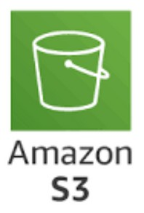
AWS S3
Simple Storaofte Service
STEMUP

Slide 2






S3 Versioning S3 Replication Data Encryption
STEMUP
S3 Bucket Policies S3 Storage Classes Logging Monitoring
Hosting Static website Snow Family
Storage gateway (hybrid solution)

Slide 3
STEMUP
AWS S3 (Simple Storage Service) is a cloud- based storage service that allows you to store, manage, and retrieve large amounts of data like files, images, videos, and backups securely and at scale.
It provides highly reliable, scalable object storage, making your data accessible from anywhere, anytime, via the internet.

Slide 4


Store data as objects Globally unique name
STEMUP
Region specific
Each object within a bucket is stored as a key- value pair
key is the object’s name (which can contain slashes /, mimicking directory structure) value is the content of the object (the file/data itself).

Slide 5
STEMUP
Maximum Object Size:
5 TB (Terabytes) is the maximum size for a single object in Amazon S3.
Multipart upload is recommended for objects larger than 5 GB (split the file into smaller parts and upload them separately).

Slide 6
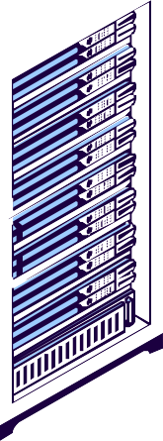


a
STEMUP
b
Mumbai
c

Slide 7
STEMUP
Host Static Website

Slide 8
S3 is used in many different scenarios. For example:
STEMUP
Web Hosting: S3 can be used to host static websites by storing HTML, CSS, and JavaScript files.
Data Lake: S3 is commonly used as a data lake, a central repository where you can store both structured and unstructured data for analytics.
Backups and Disaster Recovery: Because of its durability and different storage classes, S3 is a popular choice for storing backups and long-term archives."

Slide 9
S3 Versioning
STEMUP
It allows you to keep multiple versions of an object in the same bucket, providing protection against accidental deletions or overwrites.
When versioning is enabled, S3 stores every version of an object, allowing you to recover older versions if needed, making it ideal for data safety and backup.

Slide 10

S3 Replication
STEMUP
It allows you to automatically copy objects from one S3 bucket to another, which can be
within the same region (Same-Region Replication - SRR) or in different regions (Cross-Region Replication - CRR).
It's commonly used for compliance, redundancy, and to improve data access performance by maintaining copies closer to your users.

Slide 11
S3 Bucket Policies
STEMUP
JSON-based access control policies that you attach directly to an S3 bucket to manage permissions for accessing the bucket and its objects.
They allow you to define who can access the data and what actions they can perform, such as read, write, or delete, enabling fine-grained control over the security of your data stored in S3.

Slide 12


Write or paste your JSON policy in the Bucket Policy editor.
STEMUP
You can use AWS’s Policy Generator to create a custom policy, or you can manually write the policy in JSON format.
GetObject: Used to retrieve or download files from an S3 bucket.
PutObject: Used to upload or add files into an S3 bucket.

Slide 13
STEMUP
S3 Storage Classes

Slide 14
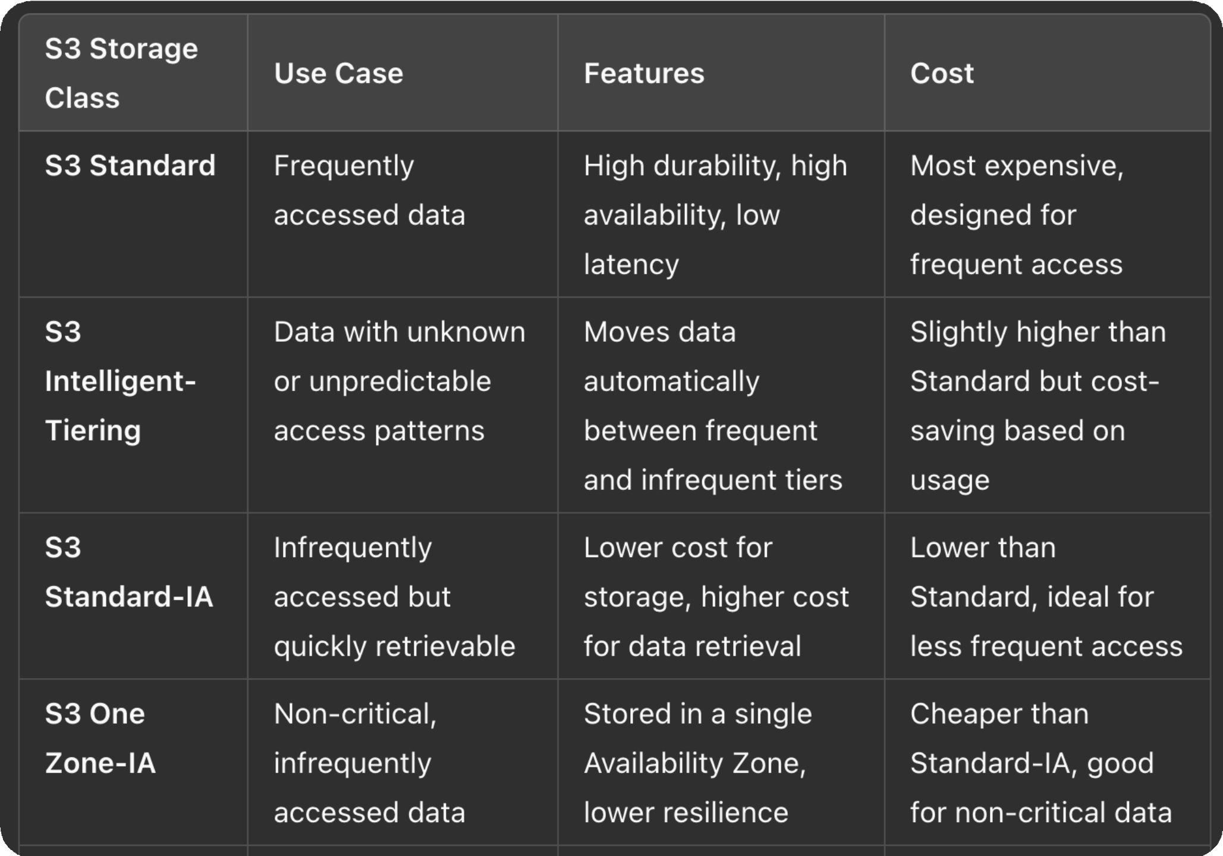

Slide 15
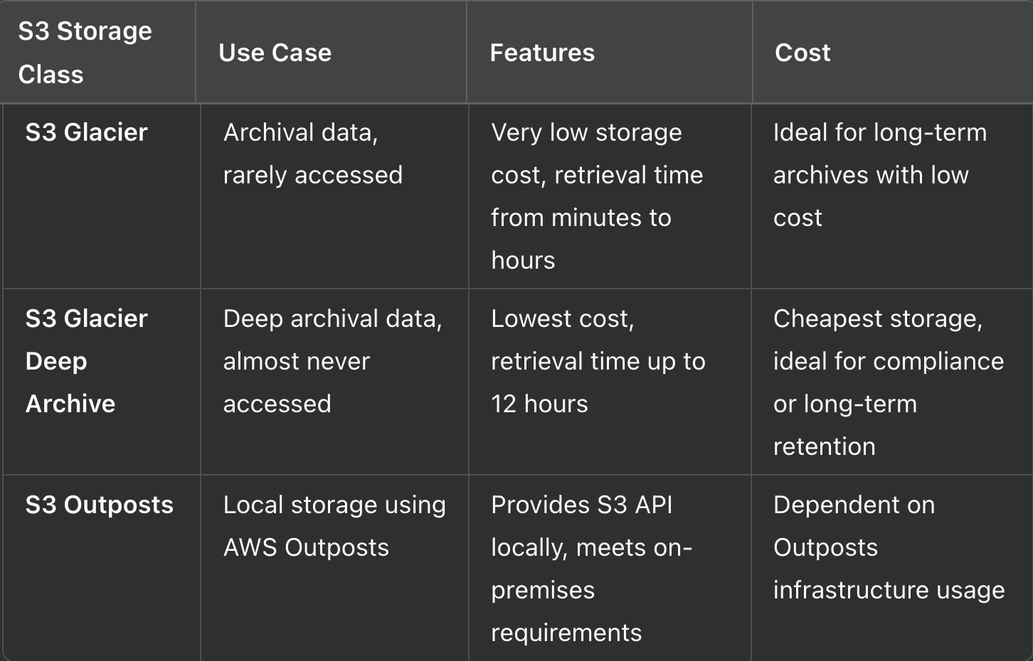

Slide 16
S3 Bucket Lifecycle
STEMUP
You can use lifecycle policies to control the movement of objects between different storage classes or delete them entirely, based on specific conditions like age or inactivity.

Slide 17



There are two main types of actions that you can define in a lifecycle policy:
Transition Actions: This action is used to move objects to a different storage class. You can move objects to cheaper storage classes as they age and are less frequently accessed.
For instance:
Move objects from S3 Standard to S3 Standard-IA (Infrequent Access) after 30 days.
Move objects from S3 Standard-IA to S3 Glacier after 90 days.
Move objects to S3 Glacier Deep Archive for long-term retention after a specific period.

Slide 18



There are two main types of actions that you can define in a lifecycle policy:
STEMUP
Expiration Actions: This action is used to delete objects after a specified period. You can set rules to permanently delete objects when they are no longer needed, such as:
Delete objects after 365 days.
Delete old versions of objects (when versioning is enabled) after a certain period.

Slide 19
STEMUP
S3 Snow Family

Slide 20
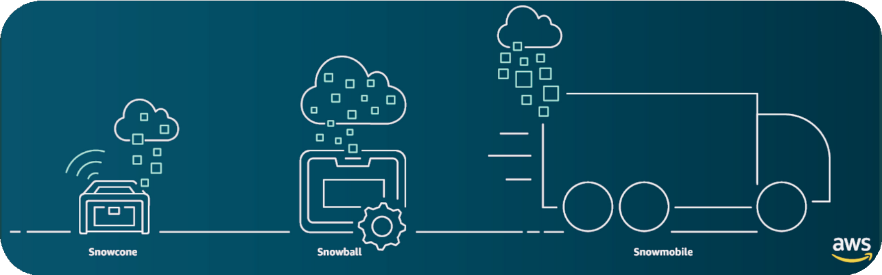
The S3 Snow Family is a group of physical devices offered by AWS to help move large amounts of data to the cloud when using the internet isn’t practical.
These devices are used when there's too much data to upload over a regular connection or when dealing with remote areas without good internet.

Slide 21

The Snow Family includes:
STEMUP
AWS Snowcone: A small, portable device for a few terabytes of data.
AWS Snowball: A larger device for moving petabytes of data and can also be used for edge computing.
AWS Snowmobile: A massive truck-sized container used for exabyte-scale data transfers, typically used by big companies moving entire data centers.
These devices help you transfer data quickly, securely, and cost- effectively to AWS, especially when internet speed or reliability is an issue.

Slide 22
Amazon S3 Storage Gateway
STEMUP
It is a hybrid cloud storage service that connects on- premises environments to cloud storage in Amazon S3. It helps extend your local storage to the cloud by acting as a bridge.

Slide 23
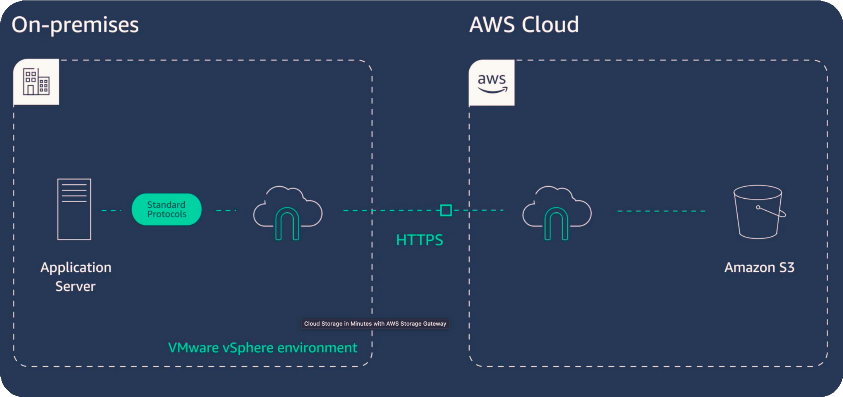

Slide 24
